Slide 1
Project: Cracking Caesar Cipher
Elvis Chu 22554150
Michael Liu 22557138
Francis Leung 22559647
Sam Leung 22559861

Slide 2

Introduction
Decryption method
Key-guessing method
Web-related function
Demonstrate
Future plan and Upgrade

Slide 3
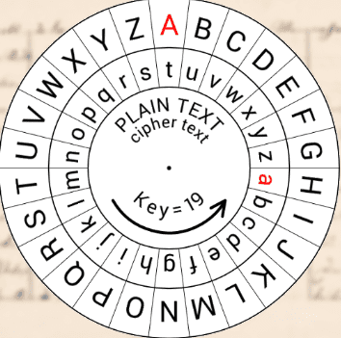
Introduction
What is Caesar Cipher ?
Simplest and most widely known
Substitution cipher
The method is named after Julius Caesar
Key = Shift

Slide 4
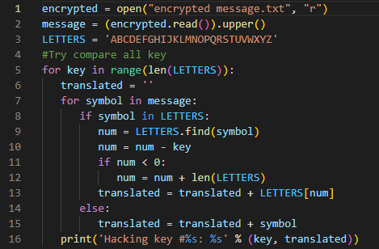
Brute force
Output is all uppercase
All possible answers
Requires common sense

Slide 5
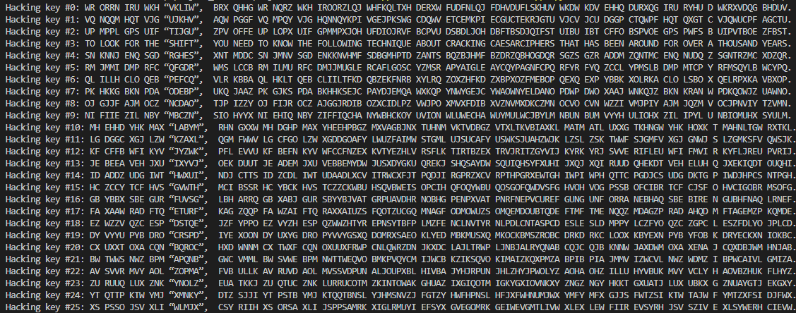
Brute Force Output

Slide 6
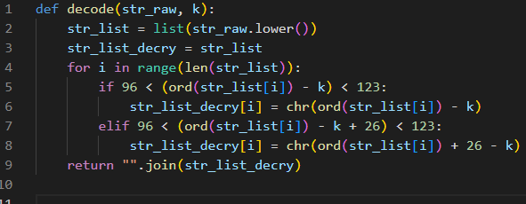
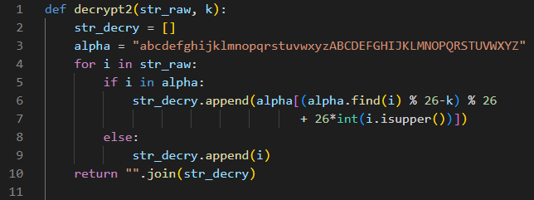
our try
First try:
Mid Efficiency
Output is all lowercase
Second try:
Mid Efficiency
Output is capable for both lowercase and uppercase

Slide 7
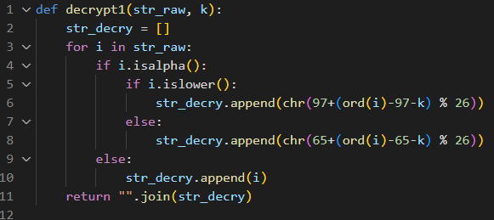
Final version
Highest Efficiency
Output is capable for both lowercase and uppercase

Slide 8
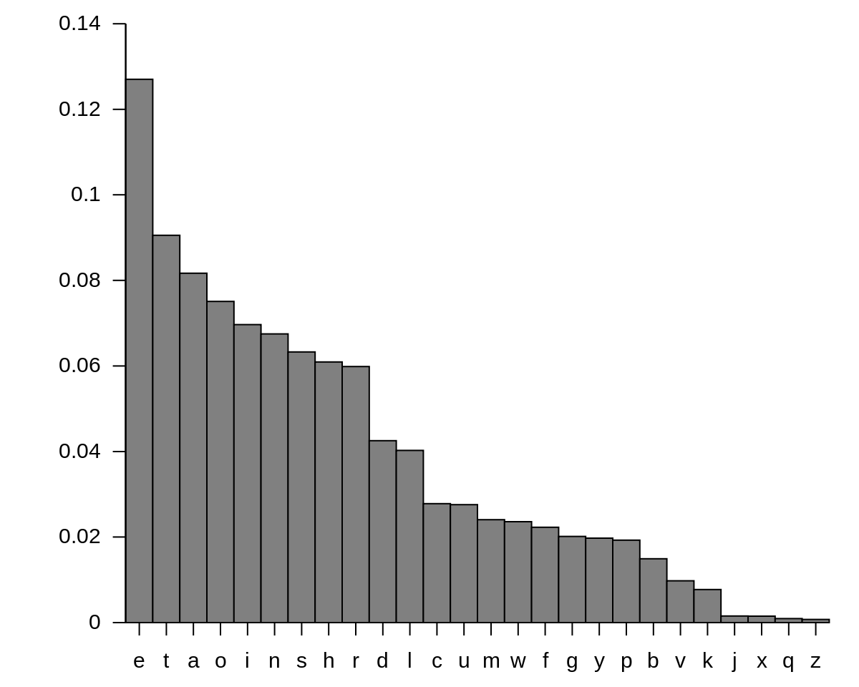
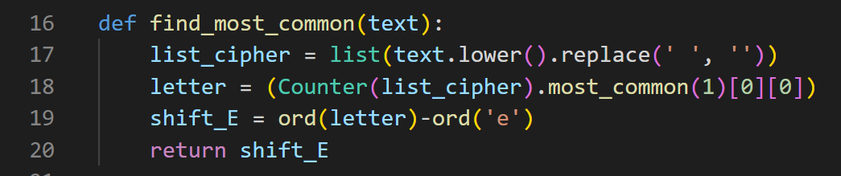
Key-guessing method
First try
find the most common letter as "e"
quick and usable in most of time but not reliable

Slide 9
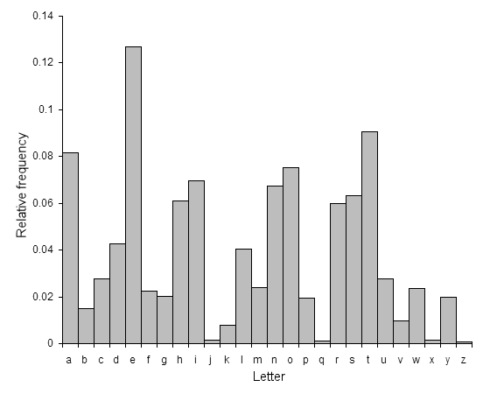
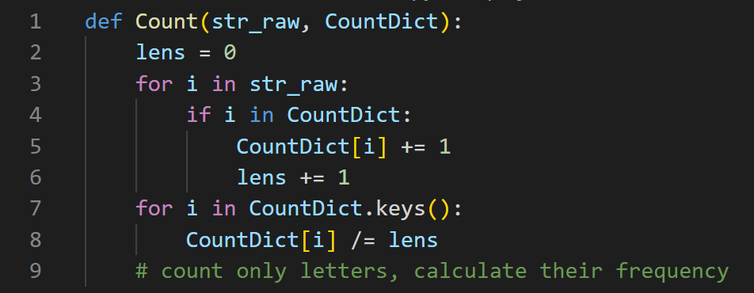
Key-guessing method
Final version
original English letter frequency table
calculate the letter frequency
in encrypted text

Slide 10
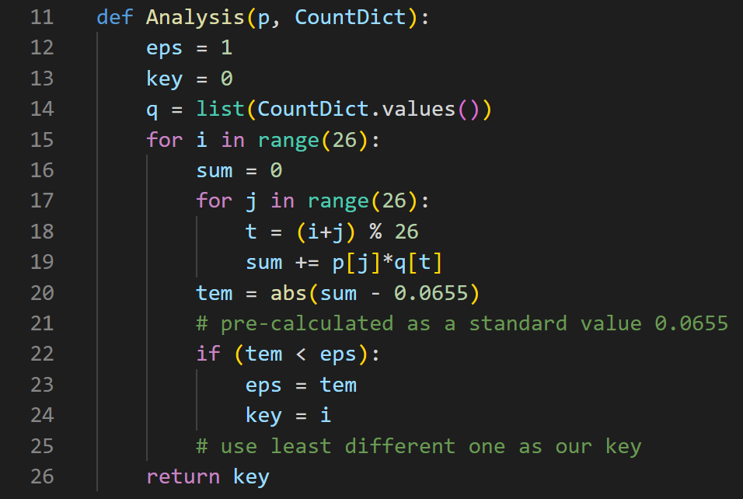
Key-guessing method
Pre-calculated dot product value (0.0655)
two “for” loop
first one: guess the key
second one: calculate the dot product
compare the difference
use the smallest one as key

Slide 11
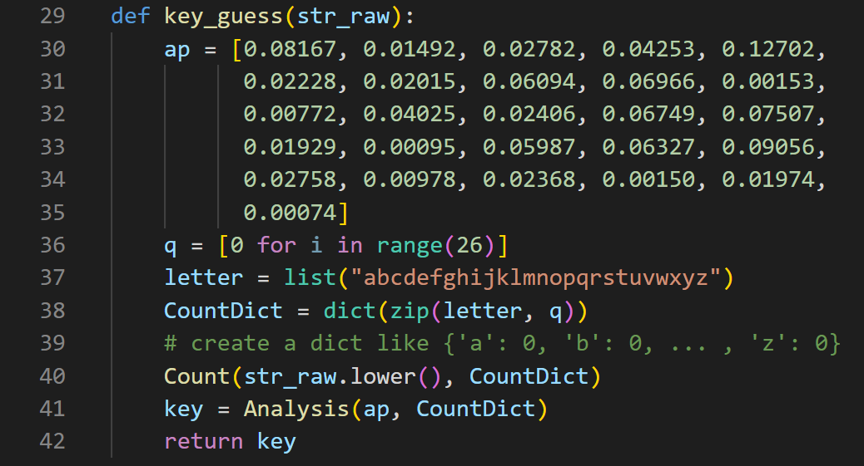
Key-guessing method
English letter frequency table
Generate a dictionary
to do following calculation
Not as efficient as find “e”
But more reliable
with a tolerable resources usage

Slide 12
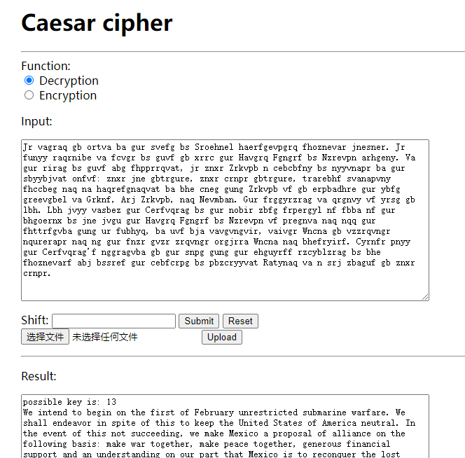
Web-related function
a fully functional web page writing with flask
encrypt/decrypt with key
decrypt with no giving key
work with upload txt file
work with json

Slide 13
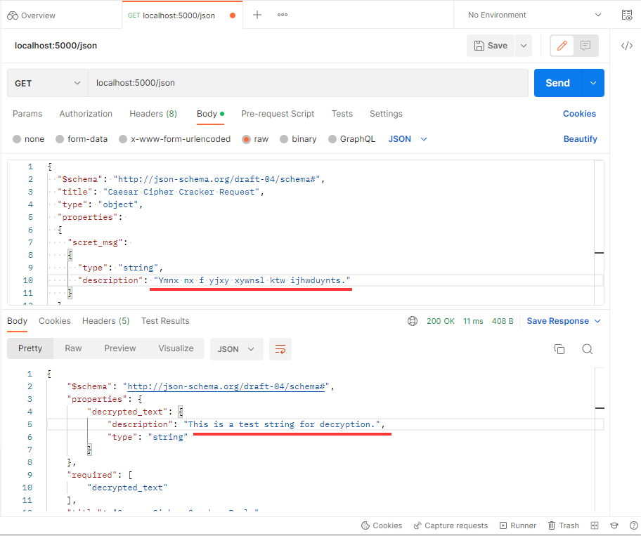
Web-related function
work with json
Postman demonstrate

Slide 14
Demonstration
Web & Postman

Slide 15
Future plan & Upgrade

Slide 16




Thank you
Elvis Chu 22554150
Michael Liu 22557138
Francis Leung 22559647
Sam Leung 22559861

Slide 17



any QUESTIONS

Slide 18
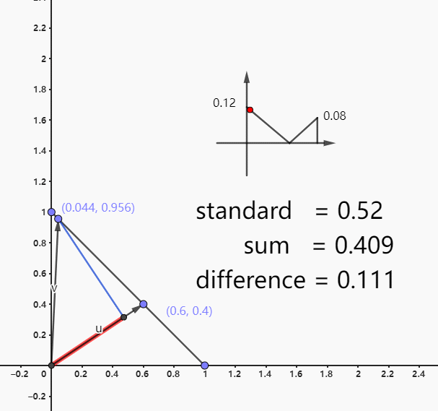
Why using dot product
2D vector demo
the sum of all element in this list is 1
we assume this array list as a vector
all possible vector point to a certain area (plane)
only the same vector (array) will have same dot product if the vector and possible plane is not perpendicular

